Slide 1

An evaluation of TSIP’s social impact
Rebekah Peters, Ruby Carter and Muyiwa Obamakin.
June - September 2021
Notes:
Rebekah

Slide 2
CONTENTS
01
02
03
04
05
Background
Introduction
Method
Insights
Conclusion
Notes:
Rebekah

Slide 3

01 BackGround
Notes:
Rebekah

Slide 4
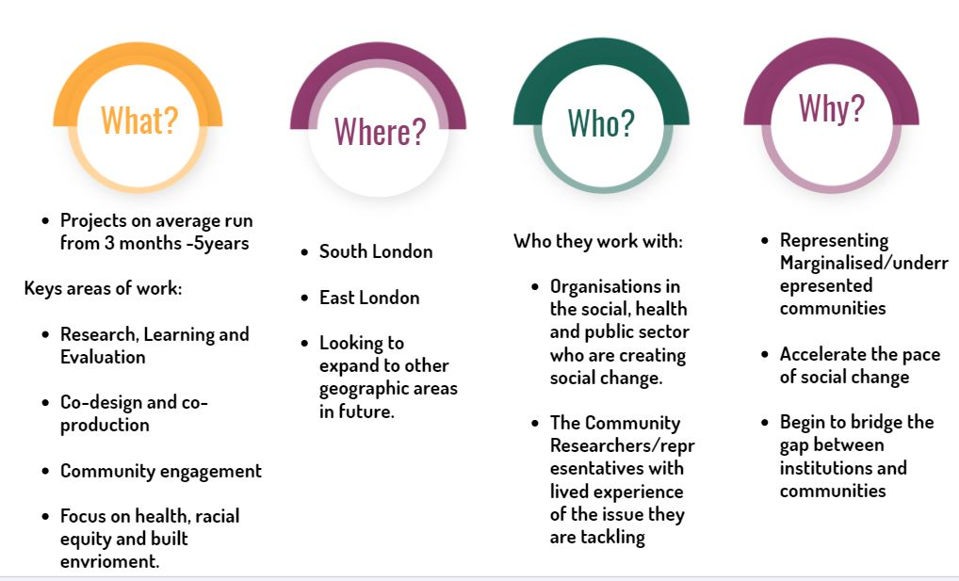
Notes:
Rebekah move slide up

Slide 5
The Social Innovation Partnership
"WE WORK WITH ORGANISATIONS WHO ARE TRYING TO DO GOOD, TO DO BETTER"
TSIP's Core Values:
DIVERSITY
EMPATHY
CREATIVITY
COLLABORATION
IMPACT
TSIP's approach to research, learning and evaluation:
INCLUSIVE
ENABLING
PEOPLE-CENTRED
EVIDENCE-INFORMED
POLITICAL
Notes:
Rebekah

Slide 6

The following are some of the companies and clients TSIP HAVE workED with:
Notes:
Rebekah

Slide 7
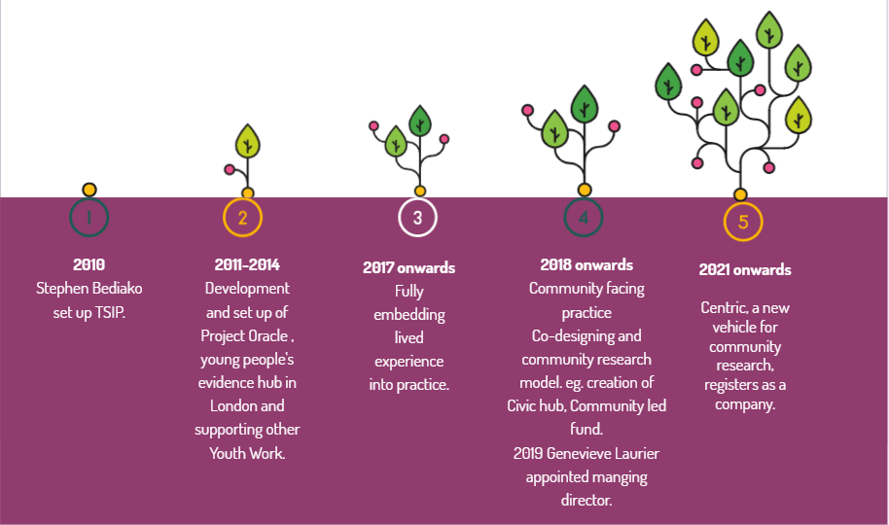
TSIP's story :
Notes:
Rebekah

Slide 8
02: AIMS
Notes:
Ruby

Slide 9

AIMS
This evaluation seeks to highlight what TSIP are doing well, as well as to see the current limitations and barriers to creating social change.
We have taken a people-led approach, using qualitative data, in order to capture nuance and depth in our report.
We highlight to TSIP what they should sustain, discard and create to make the most social impact.
Notes:
Ruby

Slide 10

03METHOD
Notes:
Ruby

Slide 11
Key Questions we asked:
Do TSIP's aims and objectives lead to social impact?​
How well have TSIP worked with their partner organisations to create social impact?
Have TSIP improved the quality of life and involvement of the targeted community​?
What are the future improvements/recommendations?
Notes:
Ruby

Slide 12
CAPTURED PERCEPTIONS OF:
Representing the unrepresented
Working collaboratively
Tackling challenging questions, societal issues, and inequalities
Creating opportunities and upskilling communities
Supporting clients in making a social impact.
Notes:
Ruby

Slide 13
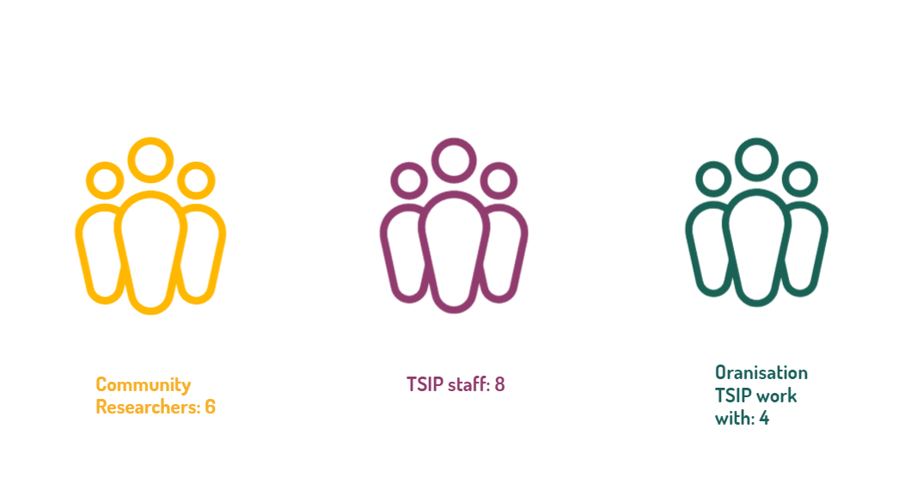
WHOM WE SPOKE TO:
Clients: 4
Notes:
Ruby

Slide 14

METHOD we used to collect data:
PERSON-CENTRED APPROACH: ALLOWING FOR NUANCE AND FOR PEOPLE TO GIVE THEIR INSIGHTS IN CONTEXT
Focus group: To hear the perspectives of community researchers in a setting that promotes dialogue.
Creative evaluation workshop: Process for TSIP team to think through strengths and weaknesses in project work.
Interviews: To provide detail on how outcomes are achieved. as well as what TSIP are doing well and where they can do better.
Notes:
Ruby

Slide 15
PROJECTS WE focused on:
Disruptive Futures: Research into young people breaking into and disrupting the creative industry.
Air Pollution Community Research: Engaging unheard voices who are affected climate crisis.
Oasis hub: Increase physical activity and health among local families.
Community-led Fund: a platform to develop ideas to improve community health.
MOPAC/VAWG Grassroots fund: Tackling violence against women and girls in London.
Med Skepticism: Insight gathering from black and other people of colour re. experiences of health inequality to make interventions and create dialogue.
Thamesmead work : Devolve decision making power in housing and empowering residents to sharpen their leadership skills and capacity to represent their communities.
Notes:
Ruby

Slide 16
04:INSIGHTS
Notes:
Rebekah

Slide 17
Representing the unrepresented
Notes:
Rebekah

Slide 18
INSIGHT 1: TSIP are good are at providing a platform to communities and uplifting unheard voices
TSIP’s community research model is highly beneficial in uplifting unheard voices as the community researchers are embedded within the key communities and have a built trust amongst them.
TSIP create a safe and open space for community members, encouraging them to speak their truths.
Recommendations: These voices could be amplified further through better dissemination e.g. more creative outputs, interactive media on the website and using social media more effectively
Notes:
Rebekah

Slide 19
"We go to massive lengths to reach people that are underrepresented more broadly in statistical data and research. And I think we've done that really effectively, we had a really strong range of voices. We were trained and we were encouraged to do that in various different ways. The fact we're in the community and the fact we have that function to start with, puts us in a naturally and really strong position. I think it's very different talking about things conceptually, in comparison to how they really are on the ground. I think that we bridge that gap to some extent, it's a quick win really to involve people already in the community. And it's absolutely common sense."
COMMUNITY RESEARCHER
Notes:
Rebekah

Slide 20
"When I first started, I didn't expect to meet such open-minded people. We were able to be open with each other, say our true opinions without being judged or criticized. And I think it does help us to be able to have our own voice on what's going on, especially because we are in the community and we are seeing people go through all of these experiences and we ourselves have probably gone through exactly the same experiences."
COMMUNITY RESEARCHER,
Notes:
Rebekah

Slide 21
INSIGHT 2: If TSIP were to tackle a broader range of issues and inequalities, to ensure that this impact is sustainable and substantial within these groups, they need to make sure that there is appropriate representation within the team.
    This ensures they have a good capacity and expertise level to deliver effective social impact. Scaling up could create more impact and increase efficiency.
    Recommendations: Having more representation of Generation Z on the TSIP team would increase authentic engagement with young people.
    Communities are not always geographically confined, and the nature of this is becoming more prevalent with Covid 19 and the rise of social media, TSIP could in the future tap into this area if their work continues remotely.
Notes:
Ruby

Slide 22
"So I'm interested in scaling because it will help us scale our impact, but i'm also interested in scaling because it will help us get to a point where our model is just more efficient and that means that we can translate that internal savings either, you know, reinvest into our own work and internal projects and pro bono work that we want to do or pass that savings onto clients to enable us to be able to do more for the clients that we want to work with"
TSIP STAFF
Notes:
Ruby

Slide 23

INSIGHT 3: TSIP has good intentions to create social change and uplift marginalised voices but the implementation doesn’t always happen.
TSIPs positioning as a ‘middle-man’ and facilitator of project co-design and co-production means that control and follow up on project implementation is limited.
Recommendation:
  Conduct future reflection on project implementation after a project has been closed. Make this a consistent and embedded practice for all projects, this will allow TSIP in the future to more clearly know the impact they are making.
Notes:
Rebekah

Slide 24
"…. But I think we've done plenty of projects where we've done the project and then that was kind of it. For example, at present for the new piece of work, we are co-designing a project with the community but then the client has to deliver it and not us, so we can design this whole thing, but if they don't do anything with it, then the work won't be sustained. I don't think we intentionally ever look to get into work that won't be sustained. We usually hope to get into work that will build community capacity or build the client's capacity so that they can sustain the work. But a lot of times that doesn't happen and we don't have the capacity nor the way the business is structured to follow up and make sure that the social impact is being sustained"
STAFF
Notes:
Rebekah

Slide 25

Working collaboratively
Notes:
Ruby

Slide 26
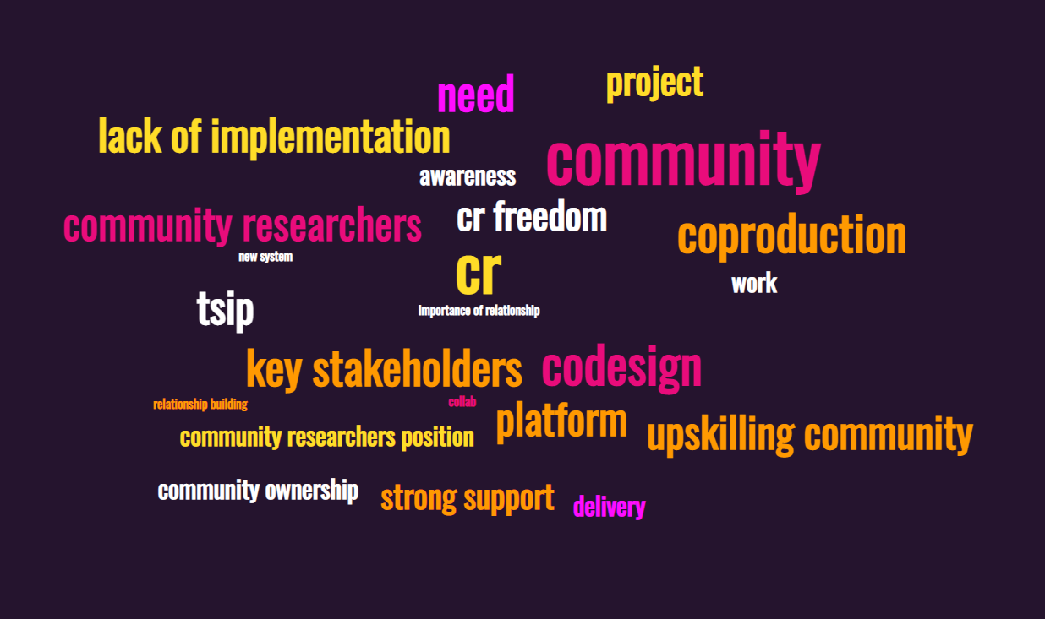
COLLABORATION:
Notes:
Ruby

Slide 27
INSIGHT 4: TSIP act as a bridge between clients and communities, yet to ensure full co-production community members could be involved more in high level decision making.
  Community members’ voices are genuinely valued by TSIP, there is flexibility and freedom for community representatives to have a significant influence on each stage. The community fund is exemplary of this. This is largely due to the strong relationships the TSIP team have with the community.
  Although the process of research is collaborative, the community need more influence to shape the implementation of research to make sure that findings are not watered down at the end.
  Recommendations:
  Genuine collaboration requires more time and is more costly so TSIP need to effectively explain how crucial the processes are.
Notes:
Ruby

Slide 28
DESIGN AND IMPLEMENT CHARTER
RECOMMENDATION
TSIP should create a written charter to set terms and conditions of project collaboration, outlining what TSIP expects the client to deliver, ideally this should be co-written with the community representatives.
This document can be referred to increase accountability and improve the operations of projects.
It needs to be used consistently and by all members of the team.
Within this charter it should detail that clients cannot significantly edit findings from the community. This will ensure that the research is not extracted.
The lack of accountability that TSIP currently has in place in how the clients implement the data undermines community members’ positions
Notes:
Ruby

Slide 29
INSIGHT 5: TSIP ARE Beginning TO BECOME MORE PROACTIVE BUT COULD DO MORE in terms of thinking ahead and what can be done next to ensure that collaboration is sustained.
TSIP need to think more ahead in terms of what comes next after data gathering and outline to clients why they are the right people to deliver it.
The team are creative and innovative but these assets need to be put into practice to make sure that TSIP is constantly evolving to the current climate to avoid complacency.
Recommendation: Instead of being shaped by trends in the social sector TSIP should be bolder in responding to current needs of the community. The medical scepticism project is a great example of this.
Notes:
Rebekah

Slide 30

PROACTIVITY
"I think we could explore and investigate whether there new areas which we can propose and devise strategies and research plans for, and then see if we can get any traction from potential funders for that"
TSIP STAFF
Notes:
Rebekah

Slide 31
Creating opportunities and upskilling communities
Notes:
Ruby

Slide 32
INSIGHT 6: TSIP ARE VERY GOOD AT CREATING OPPORTUNITIES FOR COMMUNITY MEMBERS BY HARNESSING LIFE EXPERIENCE AND DEVELOPING THEIR SKILLS
  The opportunities TSIP provide for the communities they work with include participation in key decision making, research, project design, data analysis and skills training.
  Ensuring that their collaborative relationship with the community is maintained prevents their work from being extractive and empowers people to be a part of the social change that they envision for their community.
Many of TSIP’s community researchers had a prior interest or experience of working in community engagement however some were not aware of how such work could be integrated into a practical real-world model that suited their daily lives. TSIP’s community research model does exactly that.
Notes:
Ruby

Slide 33
"I really trusted in TSIP's ability to build relationships in our local area where we perhaps had struggled before. It's very difficult as a funder to sometimes build equitable relationships in the place of working because you're the one with the money. So the dynamic is very difficult to do. Sometimes people can't see are beyond our role as a funder, even though we are a broker of relationships and we do bring people, we do convene people together, but they'll always be the money elephant sitting in the middle of the table. So I think having a partner like TSIP, who was able to go out and build relationships and talk to others about our ambitions about devolving funding into the neighbourhood has been really good".
CLIENT
Notes:
Ruby

Slide 34
"I was asked to come to a training day, and for me it did change my life because at the time I didn't have a job, it was deep in the pandemic time. And I liked it because I was passionate about what I was doing. We were passionate about what we were doing. You could see what you were doing was helping and changing others in that time."
COMMUNITY RESEARCHER
Notes:
Ruby

Slide 35
"I feel like I've been given a second chance at a new career path, because I had quite a lot of experience in the community, a lot of quite political things, a lot of activism, but things that are not usually quantifiable or asked to be quantified. Things you wouldn't put it on a CV or in a job application necessarily. As a result of that, the way that i've lived my life I’ve often felt like a lot of the things that I've done, which I know have had an impact, they haven't been measured. I haven't necessarily been able to utilize them. And so for me coming through this program and the fact my lived experience is considered a skill in its own right, has really been transformative."
COMMUNITY RESEARCHER
Notes:
Ruby

Slide 36
INSIGHT 7: TSIP ARE EXPERTS IN WORKING WITH THE COMMUNITY DUE TO THEIR LIVED EXPERIENCE AND KNOWLEDGE OF THE COMMUNITIES, HOWEVER, MORE CAN BE DONE TO TAP INTO THE EXPERITSE WITHIN THE TEAM.
The TSIP team is composed of a diverse range of individuals, each bringing a different lived experience and perspectives. Many of the team come from or have links with the communities that TSIP work with, placing them in a unique position to ensure inclusivity and diversity in their work and sustain the support provided for the community.
Recommendation: The range of expertise areas include: community engagement, youth work, Ethnic minority groups (mainly black people), public health, violence against women, areas of activism,, politics, crime, LGBTQ, gender equality, creative industries, entrepreneurship, mental health. TSIP must do more to harness these areas to maintain a broad work catalogue and create a more directional social impact.
Notes:
Rebekah

Slide 37
"TSIP need to look inward, instead of looking at the external factors, such as what is trending, what are other organizations doing, what is in the market currently? Instead of looking for the gaps and then plug in the gaps with your expertise, you see what expertise you have, you see what interests lies and you build from that. Because you have that existence in the company, like, high level skillsets, lived experience, insights into so many different things, people that speak five languages and people that come from different parts of the world. You use that to your advantage. You don't just let that settle. You need to be progressive."
TSIP STAFF
Notes:
Rebekah

Slide 38
Tackling challenging questions, societal issues, and inequalities
Notes:
Ruby

Slide 39
INSIGHT 8: TSIP EXCEL IN SUPPORTING CLIENTS TO MAKE A POSITIVE SOCIAL IMPACT, MEETING THE TARGET COMMUNITIES NEEDS WITH COMPLETE INTERGRITY AND CONFIDENCE IN HAVING UNCOMFORTABLE CONVERSATIONS
TSIP's unique position ensures that they can communicate the community’s needs and perspectives in a safe and appropriate way that ensures client understanding. TSIP’s passion for doing what is right and considering the needs of the community means they have the confidence to have uncomfortable conversations with clients or challenging their ways of working to promote learning and a better social impact.
However, an important factor to ensure successful learning, is a client’s openness to learning and potentially changing their ways of working.
Also, TSIP are reflective on how they themselves can better serve the community
Recommendation: TSIP could improve in their ability to clearly communicate to clients when things go wrong operationally in a project.
Notes:
Ruby

Slide 40
"The team is good at challenging us - following up and using the insights in the right way."
"TSIP have incredible foresights and have an energy and a confidence to challenge, I think that's what's really impressive. They have pushed us at times to work smarter and be bolder"
CLIENTS
Notes:
Ruby

Slide 41

INSIGHT 9: TSIP NEED TO CREATE A CLEARER UNIFIED VISION OF IDENTITY IN THE DIRECTION OF SOCIAL IMPACT
Recommendation:
  Refine the TSIP identity and to create a clearer vision to make crystal clear who TSIP are, who they worked with, who their target communities are, what their work involves and what they are experts in.
  TSIP need to improve how they showcase their identity by creating a better profile e.g. on online platforms
  Make slogan sharper and more direct. Make it include the community facing element.
The societal issues and inequalities that TSIP tackle have a particular focus on South London communities, marginalized groups including black and ethnic minority groups and young people.
There is a lack of clarity and confusion around the TSIP brand/identity, this is reflected internally and externally.
The whole team on every level need to be able to clearly communicate TSIP'S vision.
Notes:
Rebekah

Slide 42
"Unclear on what expertise and skills TSIP has beyond community engagement and research"
CLIENT
"I do wish that we could have more creative outputs, I wish that it wasn't just always like a report. I think we could definitely utilize online platforms and social media more."
STAFF
"So what needs to take place is to really define what it is that you do. What is your expertise? What is your service offering coupled with what is the expertise within your organization? Then you have an identity, you know what you're good at, you know what you can offer in whatever space that you want to work in."
STAFF
Notes:
Rebekah

Slide 43
05: Recommendations
Notes:
Rebekah - conclusion

Slide 44
Key Recommendations:
  Improve on dissemination of outputs for better engagement outreach, utilising more creative and cutting edge methods.
  Clearer brand identity to showcase the skills and expertise that TSIP have. As well as better articulating TSIP’s story of development on online platforms.
  Embed reflection into TSIP's practice to ensure implementation of outputs and more knowledge on their impact.
  Create charter to improve accountability and ensure smoother collaboration.
  Harness the expertise of the team more and make the skills that they have more prominent on their website and social media.
  Improve operational communication with clients, for example on budgeting, timings and staff changeovers.
  Increase interactions and communication with the board so that there is coherence in their future development. Arrange to hear the board’s perspectives on TSIP’s social impact.
  R
Notes:
Rebekah

Slide 45
Thank you!

